Slide 1
HTML & CSS
Sofyan Thayf

Slide 2
Anatomy of A website
Your Content + HTML: Structure + CSS: Presentation = Your Website
A website is a way to present your content to the world, using HTML and CSS to present that content & make it look good.

Slide 3
CSS
CSS = Cascading Style Sheets
CSS is a "style sheet language" that lets you style the elements on your page.
CSS is works in conjunction with HTML, but is not HTML itself.

Slide 4
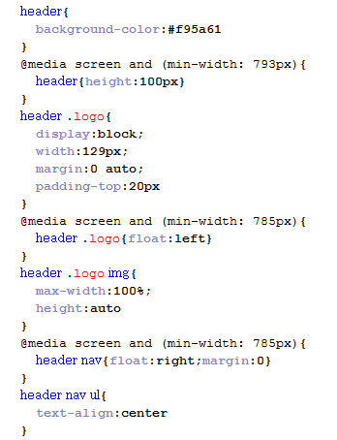
CSS

Slide 5
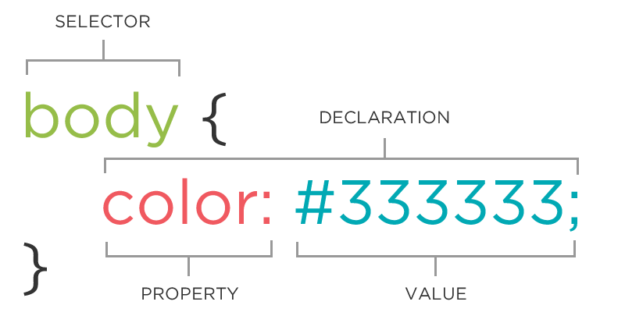
CSS Rule

Slide 6
Connecting HTML + CSS
Inline
<p style="color:red">Some text.</p>
Embedded
<head>
<style type="text/css">
p { color: blue; font-size: 12px; }
</style>
</head>

Slide 7
Connecting HTML + CSS
External
<head>
<link rel="stylesheet" type="text/css" href="style.css"> </head>

Slide 8
CSS Color Values
Your browser can accept colors in many different ways:
Color name (ex. red)
Hexadecimal value (ex. #FF0000)
RGB value (ex. rgb(255, 0, 0))
HSL value (ex. hsl(0, 100%, 100%))
The 17 standard colors:
aqua, black, blue, fuchsia,gray, grey, green, lime, maroon, navy, olive, purple,red, silver, teal, white, and yellow.

Slide 9
Reusing code
Don’t Repeat Yourself
ID vs Class
ID -- Should only apply to one element on a webpage, i.e., a webpage only has one footer. The "#" is how you tell CSS "this is an id."
Class -- Lots of elements can have the same class, i.e., There can be many warnings on one webpage. The "." is how you tell CSS "this is a class name."

Slide 10
CASCADING
CSS
p{ color:blue; font-family: 'Helvetica'; }
.red { color: red; }
#special { font-family: Arial; }
HTML
<p>Paragraph</p>
<p class ="red">Paragraph</p>
<p class = "red" id ="special">Paragraph</p>

Slide 11
Cascading Priority
In line CSS
ID
Class
Element

Slide 12
Cascading Priority
.main .sale .clearance p{ //Most specific
color: red;
}
.header .title p{
color: green;
}
.footer p{ //Least specific
color: blue;
}

Slide 13
Cascading Priority
a{
background-color: yellow;
}
a{
background-color: teal;
}
a{ //This rule wins
background-color: black;
}

Slide 14
CSS Selector ?
W3Schools.com

